Slide 1
Module 4.9:
Attacks
Threats to ML Cybersecurity
ML for Cybersecurity

Slide 2
Adversaries
Ethics
Attacker’s goals
Attacker’s capabilities
Robustness of model/feature
Privacy
Fairness
Transparency
Modules 2 – 4
Module 4
Module 2
Module 1
Module 4
Identify Goals & Collect Data
Data Representation
Modeling
Deployment
Pinpoint needs
Data acquisition
Data labeling
Data exploration
Data cleaning
Missing data
Feature selection
Consider fairness
Efficiency
Accuracy
Interpretability
Adversarial resistance
Performance
Evasion and attacks
Model drift
Impact on stakeholders
Module 3

Slide 3
Attacks on Deployed Systems
Threat 1: Attacker changes their data to influence their classification (model evasion)
Often based on learning how the model works
Threat 2: Attacker learns private training data (model inversion) or model parameters (model extraction)
Threat 3: Attacker feeds incorrect data to influence your model (model poisoning)
Threat 4: Attacker backdoors transfer learning

Slide 4
Attacker Models

Slide 5
Threat Models for Attacks on ML
Knowledge of model/system
White box: attacker knows internal structure
Black box: attacker doesn’t know internal structure
Can the attacker access the training data?
Can the attacker access the source code (for training or deployment of the model)?
How many queries can the attacker make?

Slide 6
Threat Models for Attacks on ML
Ability to influence the model/system
Can the attacker influence the initial training data/model?
Is data from the attacker used in model updates?

Slide 7
Evasion Attacks

Slide 8
General Evasion Attack
Attacker tries to cause a misclassification
Identify the key set of features to modify for evasion
Attack strategy depends on knowledge on classifier
Learning algorithm, feature space, training data

Slide 9
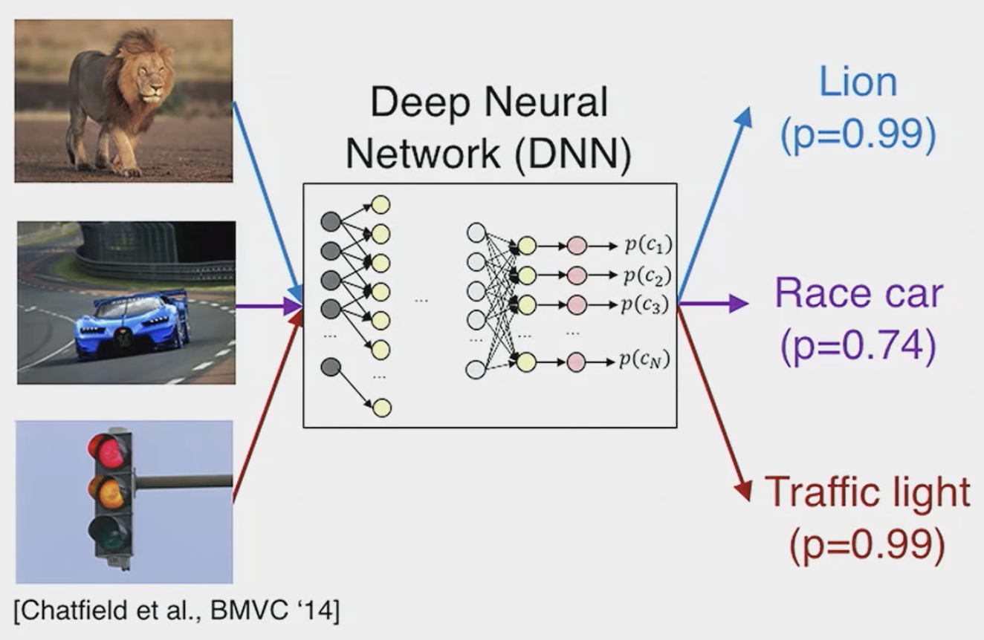
Evasion Attack (Images)

Slide 10
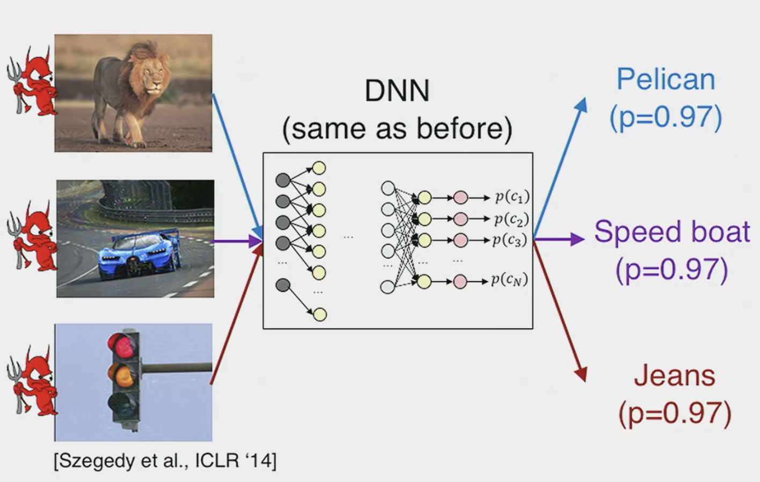
Evasion Attack (Images)

Slide 11
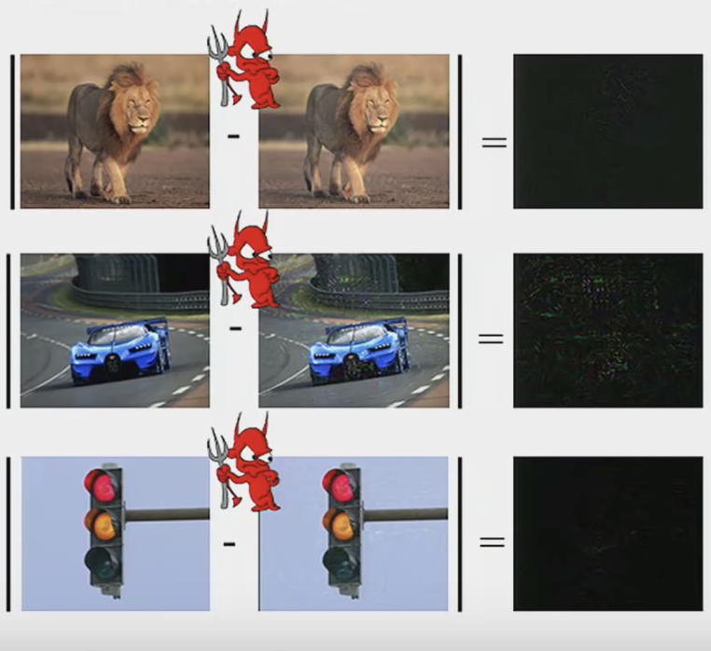
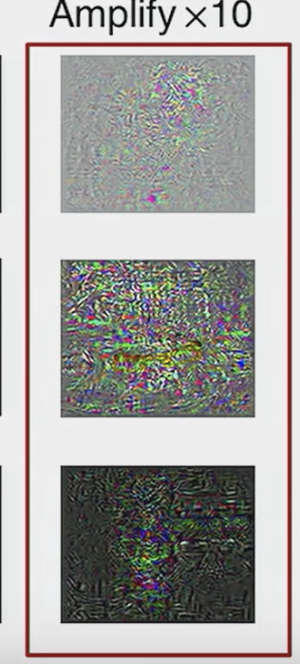
Evasion Attack (Images)

Slide 12
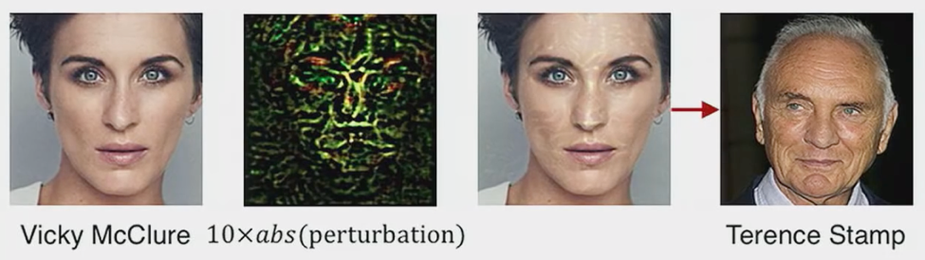
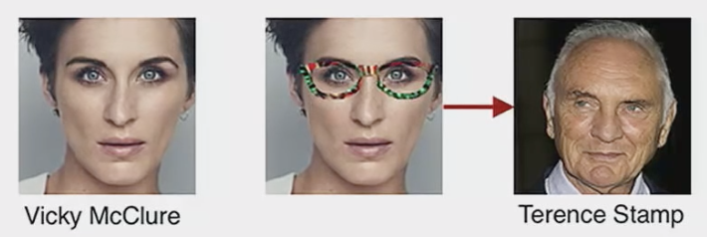
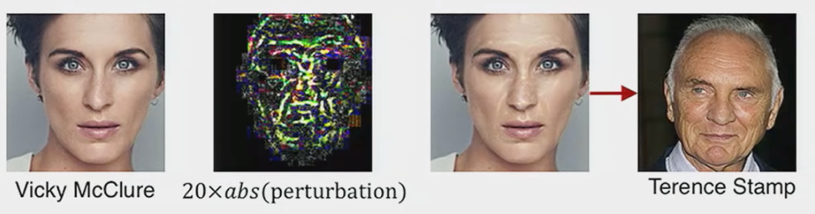
Evasion Attack (Physical World)
Sharif, Bhagavatula, Bauer, Reiter, Accessorize to a Crime: Real and Stealthy Attacks on State-Of-The-Art Face Recognition, CCS 2016

Slide 13
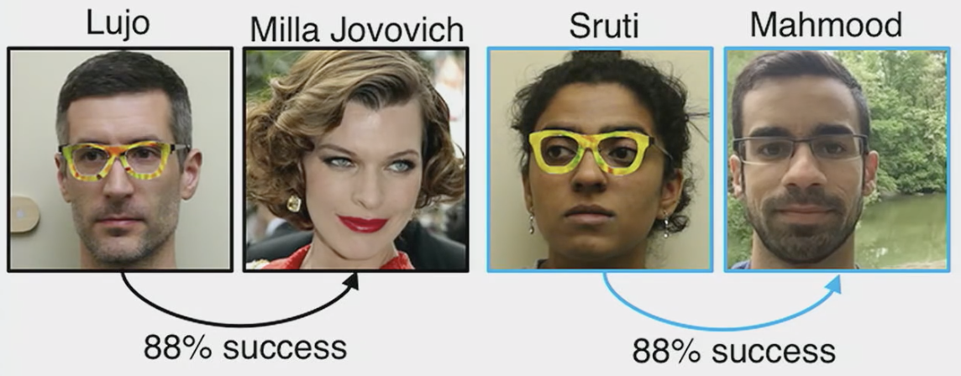
Evasion Attack (Physical World)
Sharif, Bhagavatula, Bauer, Reiter, Accessorize to a Crime: Real and Stealthy Attacks on State-Of-The-Art Face Recognition, CCS 2016

Slide 14
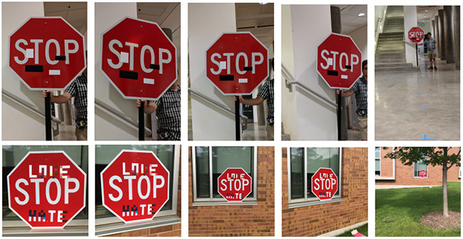
Evasion Attack (Physical World)
Eykholt et al., Robust Physical-World Attacks on Deep Learning Models, CVPR 2018

Slide 15
Model Inversion / Extraction

Slide 16
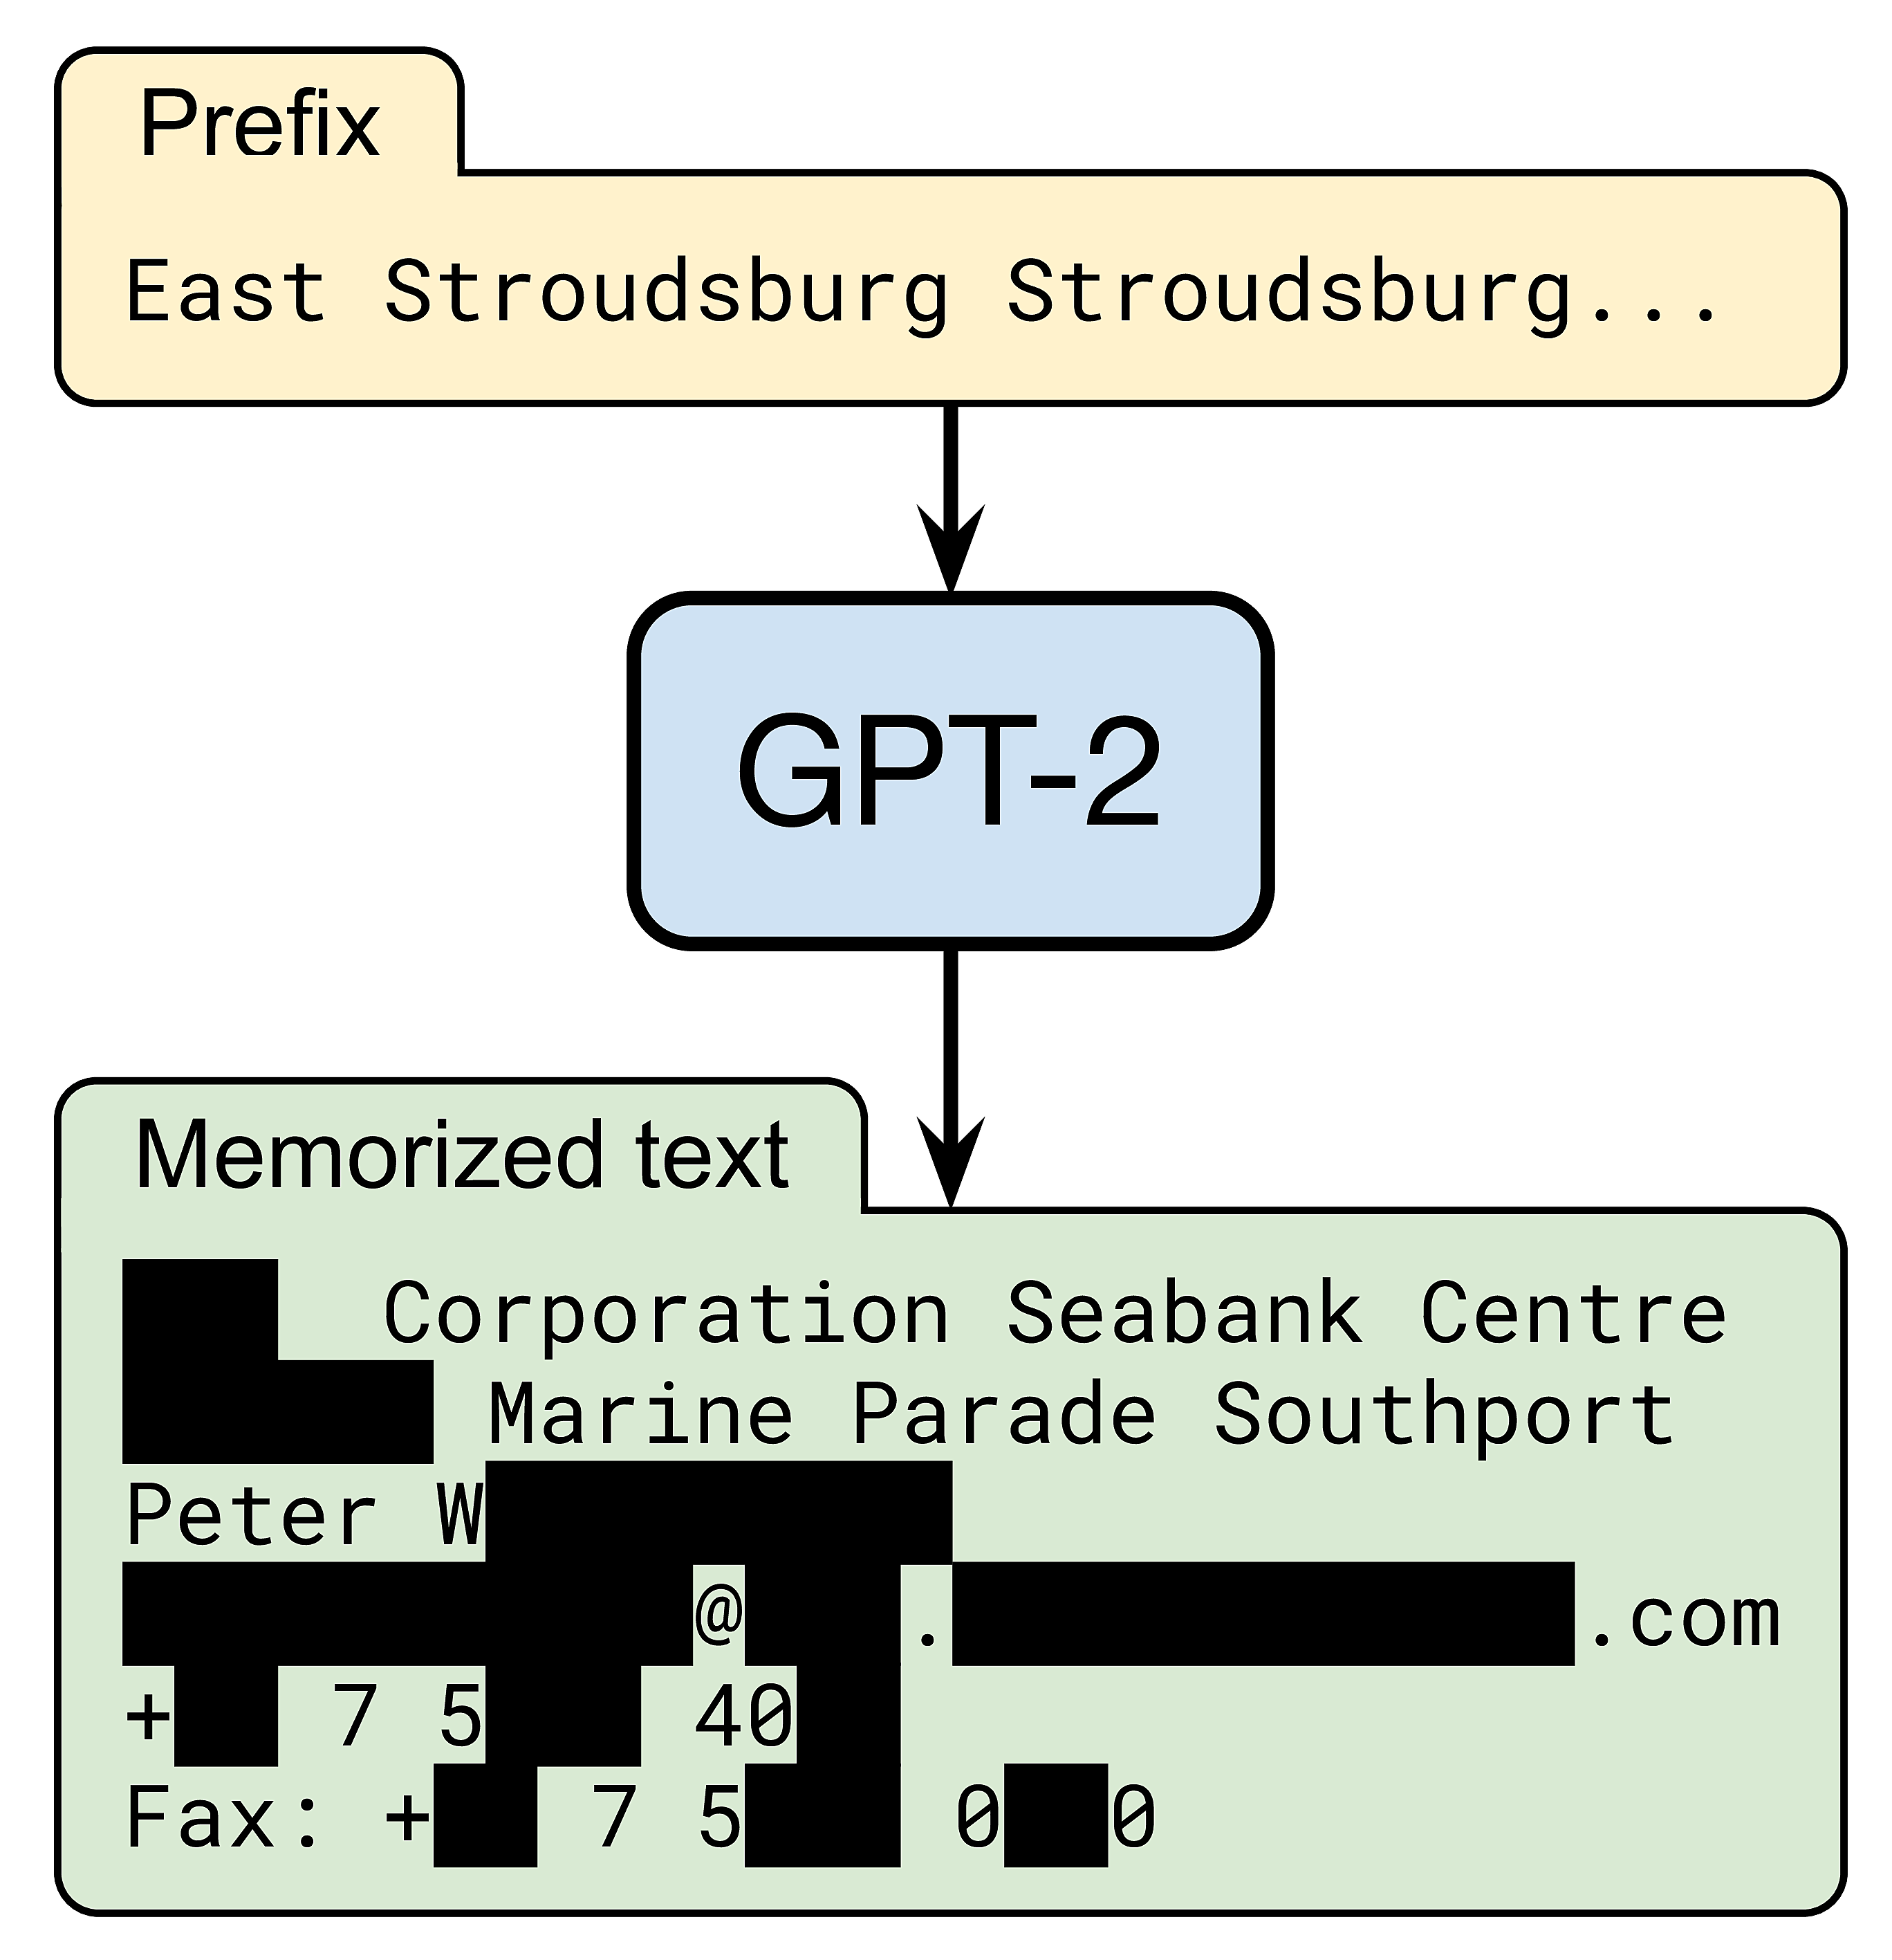
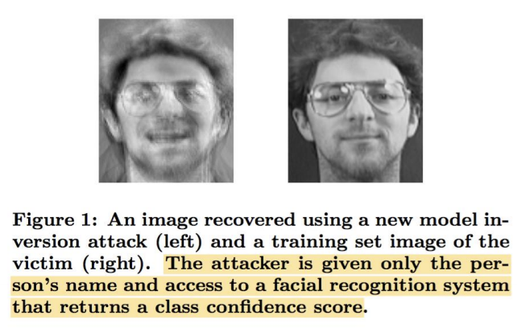
Model Inversion Attack
Extract private (sensitive) inputs used to train the model
https://bair.berkeley.edu/blog/2020/12/20/lmmem/

Slide 17
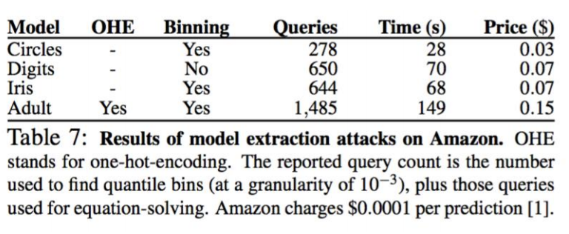
Model Extraction Attack
Extract the parameters of the model through repeated querying
Tramèr et al., Stealing Machine Learning Models via Prediction APIs, In Proc. USENIX Security, 2016

Slide 18
Poisoning Attacks

Slide 19
General Poisoning Attack
Tamper with training data to manipulate model
Two practical poisoning methods:
Inject mislabeled samples to training data ➔ wrong classifier
Inject junk data ➔ harder to train accurate classifiers

Slide 20
Attacks on Transfer Learning

Slide 21



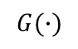
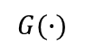
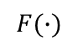
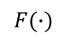
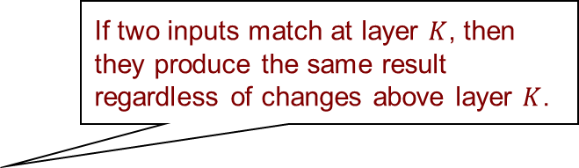
Attacks on Transfer Learning
$$F(∙)$$
$$G(∙)$$
If two inputs match at layer $K$, then they produce the same result regardless of changes above layer $K$.
Target
Image
Unchanged from Teacher
$$X_{K}$$
$$F(X_{K})$$
$$G(F\left(X_{K}\right))$$
$$X_{K}$$
$$F(X_{K})$$
$$G(F\left(X_{K}\right))$$
+
Perturbation
$$∆$$
Source
Image
$$F(∙)$$
$$G(∙)$$
Wang et al., With Great Training Comes Great Vulnerability: Practical Attacks against Transfer Learning, In Proc. USENIX Security, 2018

Slide 22





Backdoor Attacks on Transfer Learning
“Rest Area”
Trigger
“Rest Area”
“Stop”
“Rest Area”
“Yield”
Backdoored
DNN
Backdoored
DNN
“Do not enter”
“Rest Area”
Normal behavior on clean inputs
Adversarial Inputs
Attacker-specified behavior on any input with trigger
Clean Inputs
Wang et al., Neural Cleanse: Identifying and Mitigating Backdoor Attacks in Neural Networks, In Proc. IEEE S&P, 2019.

Slide 23
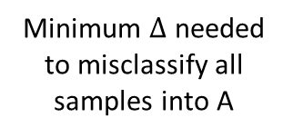
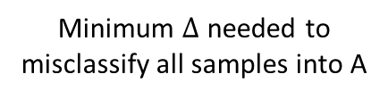
Backdoor Attacks on Transfer Learning
Clean model
Infected model
Decision Boundary
Trigger
Dimension
Adversarial samples
Minimum $∆$ needed to misclassify all samples into A
A
B
C
A
Normal
Dimension
B
C
Normal
Dimension
Minimum $∆$ needed to misclassify all samples into A
Intuition: In infected model, it requires much smaller modification to cause misclassification into the target label than into other uninfected labels
Wang et al., Neural Cleanse: Identifying and Mitigating Backdoor Attacks in Neural Networks, In Proc. IEEE S&P, 2019.

Slide 24
Business Applications

Slide 25
Attacks on ML Cybersecurity
How might an attacker try to evade your classifier?
How much do they know about your model?
How many queries can they make?
Is sensitive customer data used for training?
Can you (try to) anonymize that data prior to training? How do you know if you have succeeded?
Do you use data potentially provided by attackers for training?
Be careful about tradeoffs with model/concept drift!

Slide 26
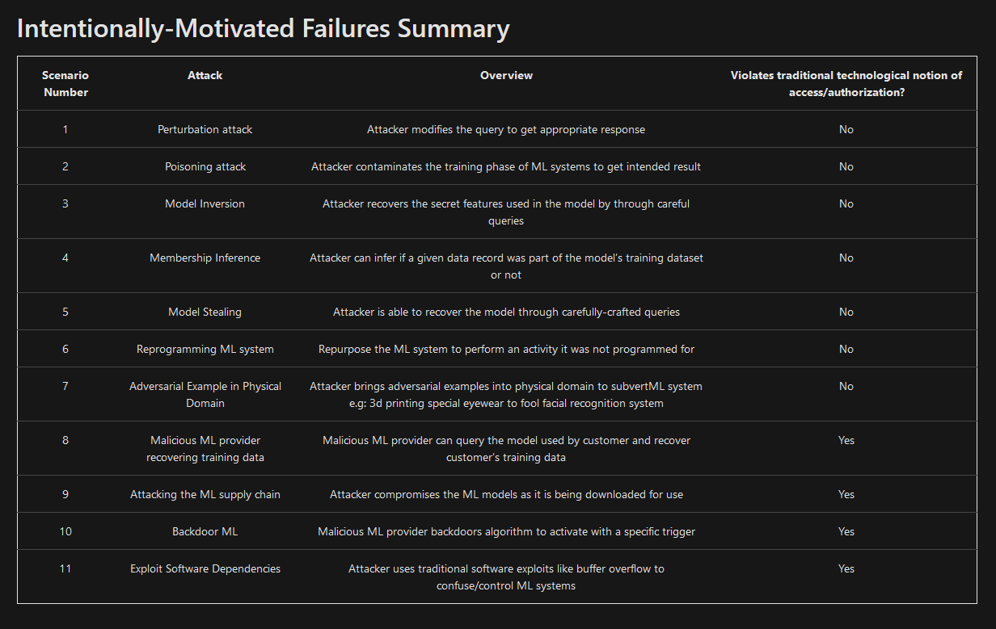
Recapping ML’s Failure Modes
https://docs.microsoft.com/en-us/security/engineering/failure-modes-in-machine-learning

Slide 27
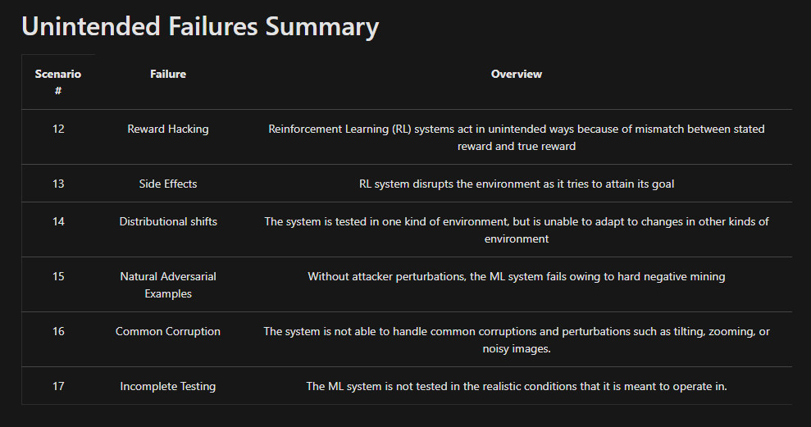
Recapping ML’s Failure Modes
https://docs.microsoft.com/en-us/security/engineering/failure-modes-in-machine-learning
Also: https://github.com/mitre/advmlthreatmatrix/blob/master/pages/adversarial-ml-threat-matrix.md#adversarial-ml-threat-matrix

